Slide 1
Customer Segmentation Using RFM Model

Slide 2
Introduction
In a world where businesses are growing tremendously, and cater to a large number of customers on a regular basis.
It becomes very essential for businesses to categorize their customers.
Customer segmentation is an effective tool for businesses to closely align their strategy and tactics with, and better target, their customers.
Every customer is different and every customer journey is different so a single approach often isn’t going to work for all.
This is where customer segmentation becomes a valuable process.

Slide 3
This project has been completed in 6 steps
1
Clustering
Data Cleaning
4
Handled Null values and cleaned the data
Finding total Number of cluster to make segment
Using k-means
2
EDA
Segmentation
5
Exploratory Data Analysis,
Man many analysis on week,month, time of purchase
Dividing the level of customer based on the clusters
3
Data Transformation
Data Visualization
6
Building of RFM Model from the given Data Set
Graphical View of final Data Set

Slide 4
1. Data Cleaning
Converted Excel to Csv File
The data set consist of 5000 row and 40 columns
After importing the data, the data must be cleaned.
In this case, there were no null values in the column.
No Missing values either in the columns

Slide 5
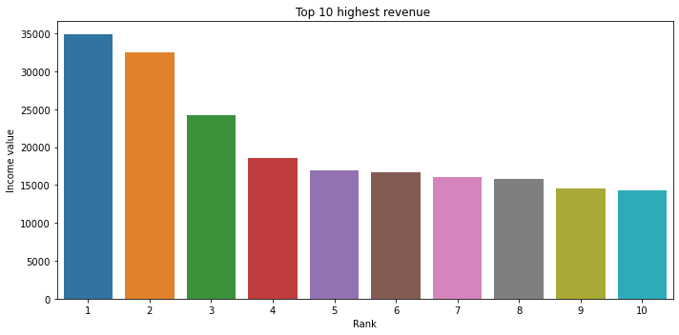
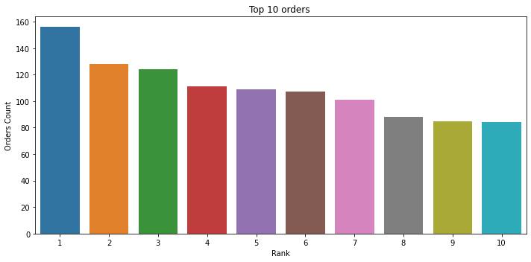
2. Exploratory Data Analysis (EDA)

Slide 6
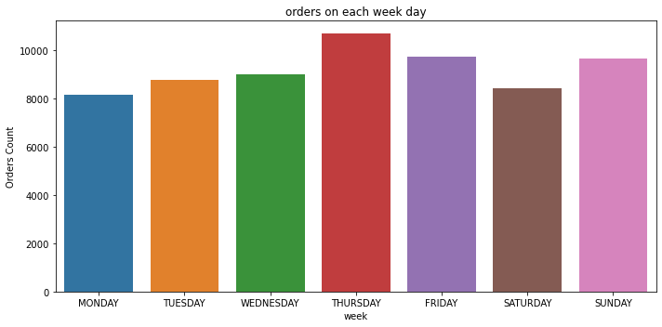
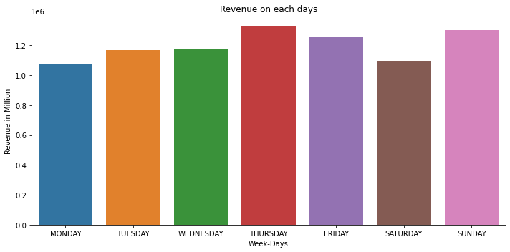
Weekdays orders and revenue

Slide 7
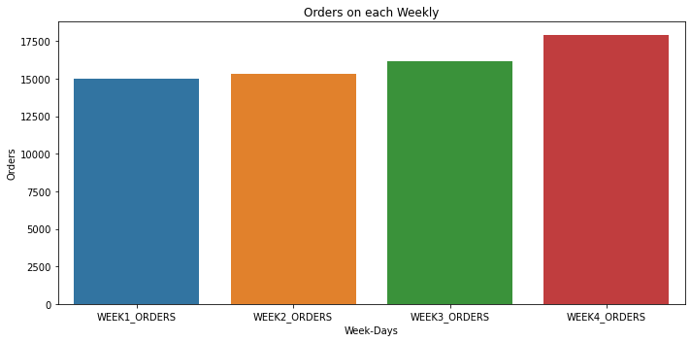
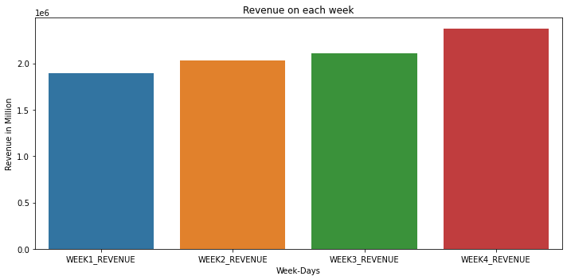
Weekly orders and revenue

Slide 8
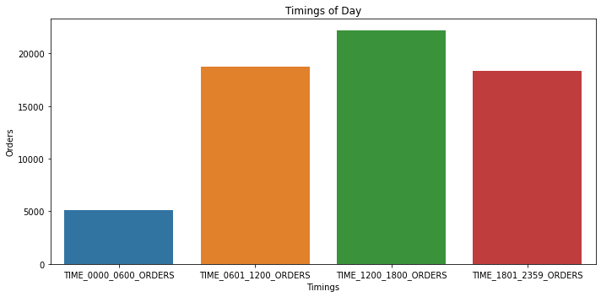
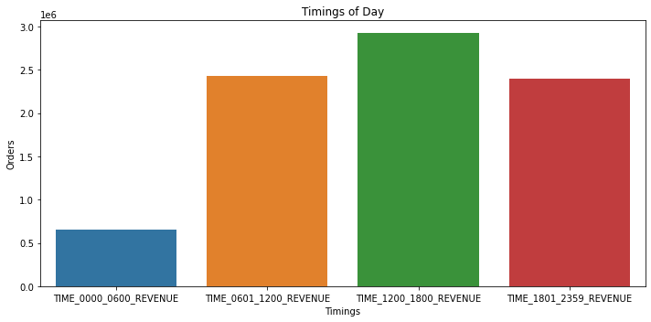
Day and Night orders and revenue

Slide 9
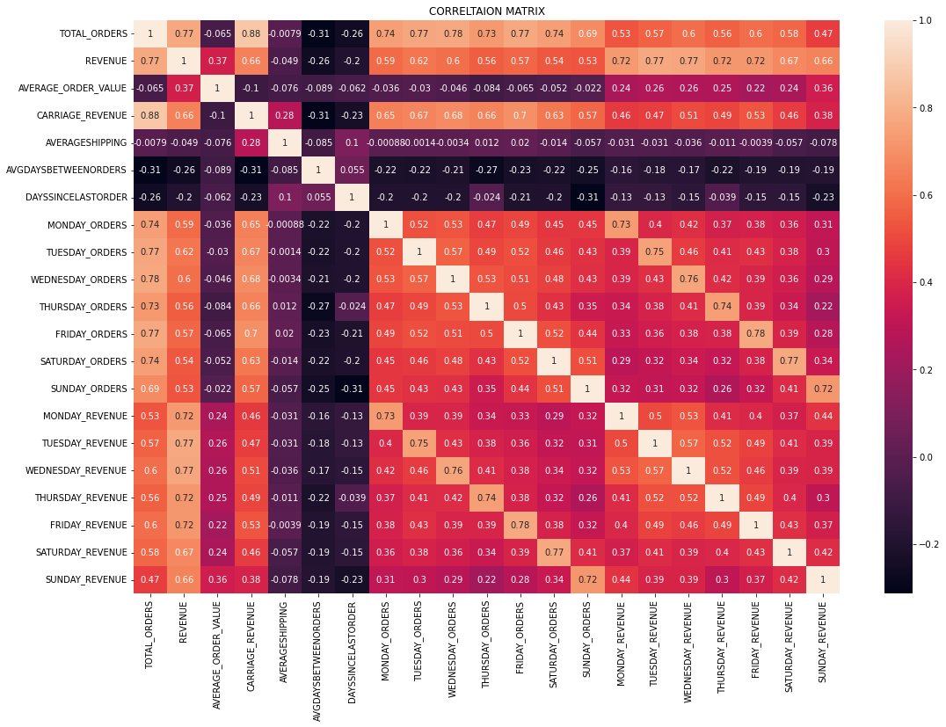
CORRELATION MATRIX

Slide 10
EDA Summary
156 is the Highest Order from a single person.
34847 is the highest revenue from a single person.
Thursday and Sunday are the Highest in revenue and Order placed.
Most Shopping happens at month End.
Some People have less order but average cost of each item is high
If person purchased more than 3 times he tends to shop more .
One can offer a special day discount on days with low orders.

Slide 11
3. Data Transformation
In this section, a Recency, Frequency and Monetary (RFM) analysis about the data is done.
Recency signiﬁes the days since order, frequency signiﬁes the number of times the customer is been billed and monetary signiﬁes the sales each customer has provided.
RFM model is used for Further Segmentation
Used standardScaler to Scale the data

Slide 12
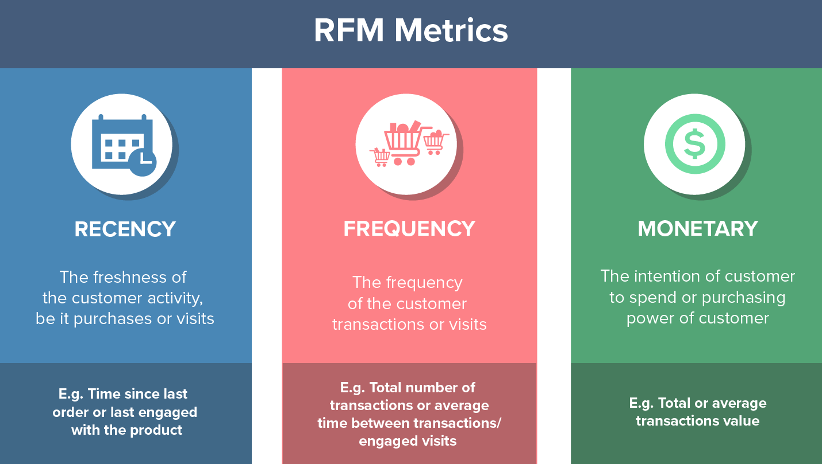
What is
RFM Analysis ?
RFM (Recency,Frequency,and Monetary Value) Analysis measures how recently , how often, and how much money a customer has given to your brand

Slide 13
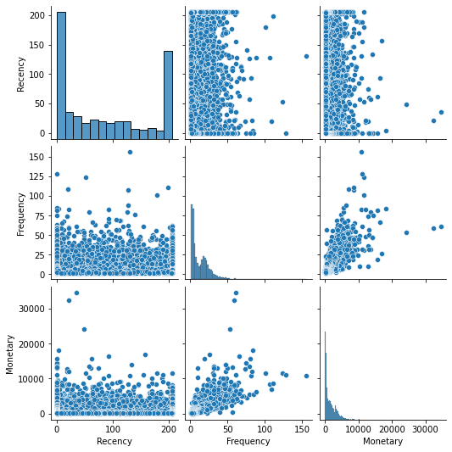
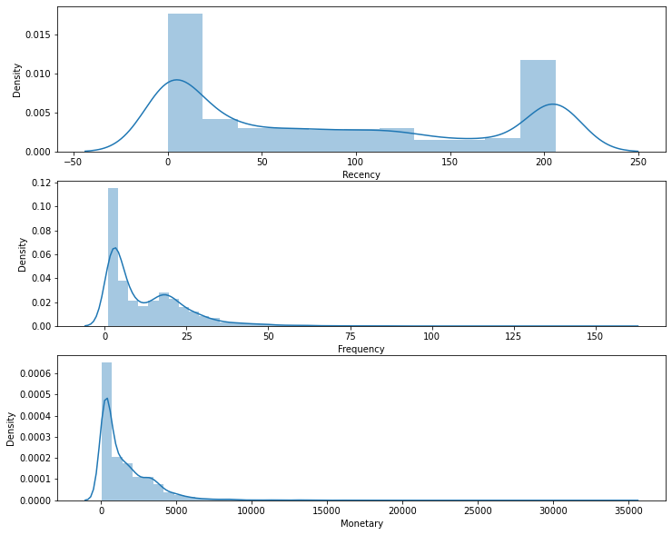

Slide 14
we can see that in recency, that we have some regulars who are buying frequently as some customer who are we losing at starting of graph and ending
and we can see that higher the frequency higher is the revenue from customers
There are many recent purchases with higher monetary value than older purchases.
Frequency and monetary variables have slight linear trend.
There are some customers who are potential outliers, but these cannot be removed because, for example there is a customerID 1 have high revenue but less order compared to customer ID26.
He could be vital to the business. There is also another customer who has frequently billed a high value. Hence, if these are removed, business could miss classifying their main customers, who could potentially be of high value in the future also.

Slide 15
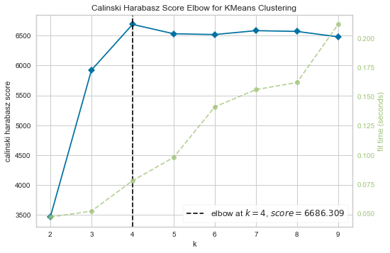
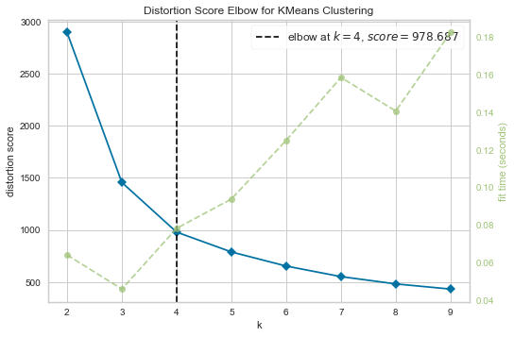
4. Clustering
K-Means requires the number of clusters to be specified during the model building process. To know the right number of clusters, we use elbow method analysis to get the number of optimal clusters
From the elbow method it is clearly understood that, 4 clusters is performing the best. Hence, 4 clusters will be selected to build the K-Means model and classify the customers.

Slide 16
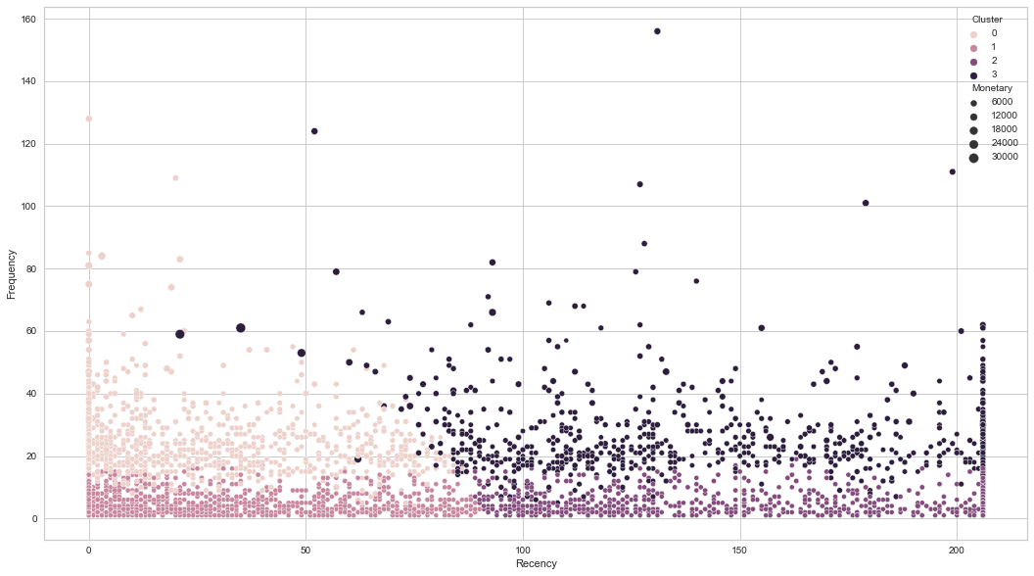

Slide 17
5. Segmentation
Score 10 and above are "Champions" and there are in top 25%
Score 8 and above but below 10 are "Loyal" and there are in top 50%
Score 5 and above but below 8 are "Potential customers" and there are in top 75%
Score 4 and above but below 5 are "promising customers"
Score below 4 are Requires Attention
Champions belongs to cluster 3
Loyal customers belongs to cluster 2
Potential customers belongs to cluster 1
Requires Attention belongs to cluster 0

Slide 18
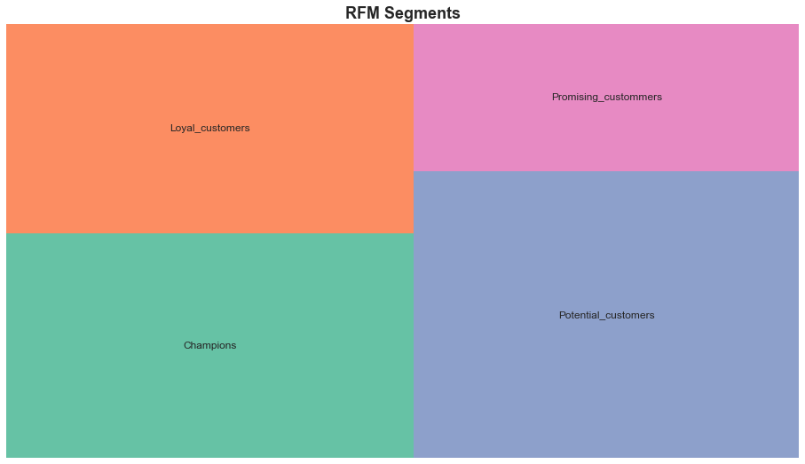
6. Data Visualization

Slide 19
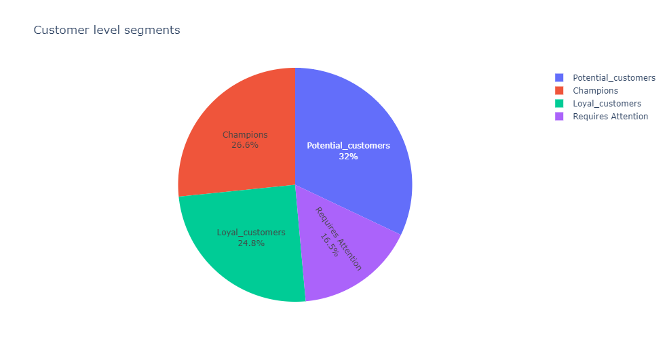

Slide 20
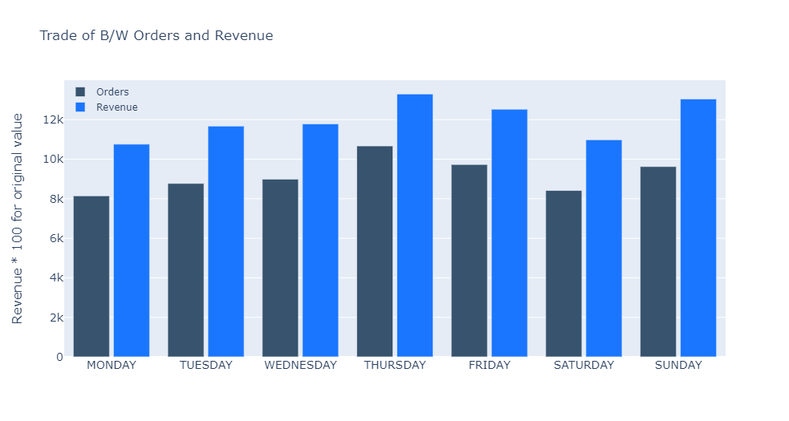

Slide 21
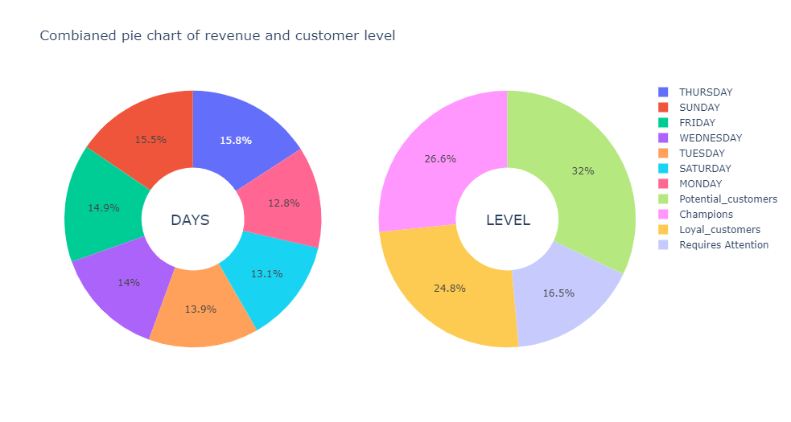

Slide 22
7. Improvement and Ideas
Giving Deals and to discount low value customers so they order More.
When we Give discount lot’s of people will buy our product By thinking they will save.
For higher Monetary valued customer we can give Prime badge with Exclusive offer and Fast and free delivery .
Hosting Flash Discount Sale on Low revenue Days may increase that day’s revenue
Building good Recommending System on customers Previous Data can make their Experience Smooth
Making your High value customer into a Influencer to promote business.
To increase frequency we must Host Flash Discount Sale on selected Items
Like KFC wednesday deal , this business must do similar type of offer on monday .

Slide 23
7. Conclusion
In this project, a translational dataset online store was used. The data set contained various columns. It contains data for almost a period of 7 year. The main aim of the project was to classify the customers into different segments. These segments will have a defining character of their own. This will help the business cater better to their customers which in turn could increase the profits.

